Slide 1
Fitness AI – Posture Recognition System
Nithya reddy Billa
Anuhya Samudrala
Ananth Pal reddy Kandhala

Slide 2
Introduction
A smart workout assistant using computer vision
Detects and tracks exercises like push-ups, squats, planks, and more
Built with MediaPipe Pose, JavaScript, and HTML5 Canvas
Provides real-time feedback, counts reps, tracks calories, and logs workout history
Designed to make home workouts accurate, fun, and data-driven

Slide 3
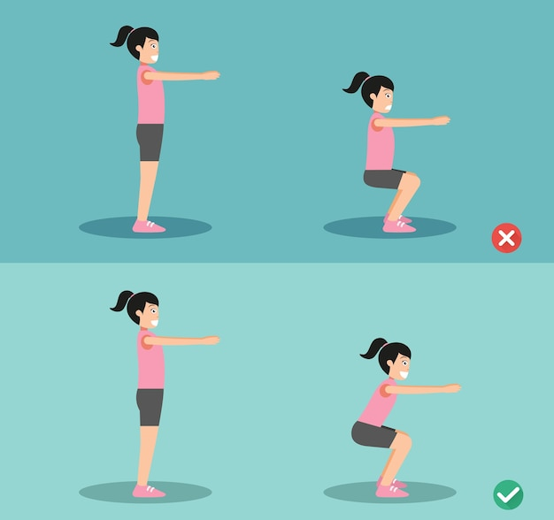
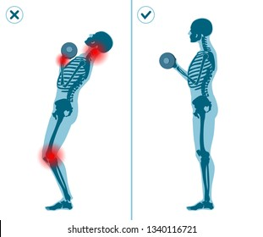

Slide 4
Consequences of bad posture
Increased Risk of Injury
Muscle Imbalances
Reduced Effectiveness of Exercises
Chronic Pain
Poor Breathing & Core Stability
Early Fatigue
Bad Habit Formation

Slide 5
Solution
Fitness AI leverages computer vision to detect your posture and guide your movements. Using just a webcam, it can:
Count reps (Push-ups, Squats, Curls, Lunges)
Time planks
Provide form feedback
Track calories burned
Maintain workout history
All of this is packed in a responsive UI that’s lightweight and user-friendly.

Slide 6
Tech Stack & Features
MediaPipe Pose for real-time pose estimation
JavaScript & HTML/CSS for a clean frontend
LocalStorage for profile & workout history
Modular architecture with easy-to-extend exercise detection logic
Calorie estimation using MET values and user profile data

Slide 7
How the Code Works
Pose Detection (MediaPipe) Loads and initializes the pose estimation model, tracks body landmarks live from the webcam.
Camera & Canvas Setup Streams video input, draws pose landmarks and connectors, and visualizes joint angles (e.g., knee angle for squats).
Exercise Detection Logic For each exercise (push-up, curl, squat, lunge, plank):
Calculates angles between key joints.
Detects stage transitions (e.g., “down” to “up”) to count repetitions.
Gives real-time form feedback on screen.
Timers & Calorie Estimation Tracks duration of plank/overall workout and calculates estimated calories based on MET values and user profile.
Workout History Logging Saves each session’s data (counts, duration, calories) in localStorage and displays it in a history table
User Profile & Exercise Settings Captures user data (weight, height, age, gender) and selected exercises to track.

Slide 8
Project features
Real-Time Posture Detection
Uses computer vision (MediaPipe Pose) to analyze body posture through a webcam.
Repetition Counter
Automatically counts reps for exercises like push-ups, squats, bicep curls, and lunges.
Plank Timer
Tracks duration of static exercises like planks to monitor endurance.
Form Feedback
Detects incorrect posture and provides on-screen visual feedback to help correct it.
Calorie Estimation
Calculates calories burned using MET values and user-specific data (age, weight, etc.).
Workout History Tracking
Stores past workouts, reps, time, and calories using LocalStorage.
Lightweight & Responsive UI

Slide 9
Initialization & Setup
Purpose: Set up variables, default values, and access DOM elements.
Constructor FitnessAI() initializes:
Counters for each exercise: push-up, squat, etc.
User profile from input fields or localStorage
DOM references to update values dynamically
Exercise tracking flags (which exercises are being tracked)
Event listeners for buttons and checkboxes
Calls initializeMediaPipe() to prepare the pose detection engine

Slide 10
Media Pipe Pose Setup
this.pose = new window.Pose({
locateFile: (file) => `https://cdn.jsdelivr.net/npm/@mediapipe/pose/${file}`
});
Loads the MediaPipe Pose model from CDN.
Sets model options like detection/tracking confidence.
Defines the callback onResults() which is called for every new frame analyzed.

Slide 11
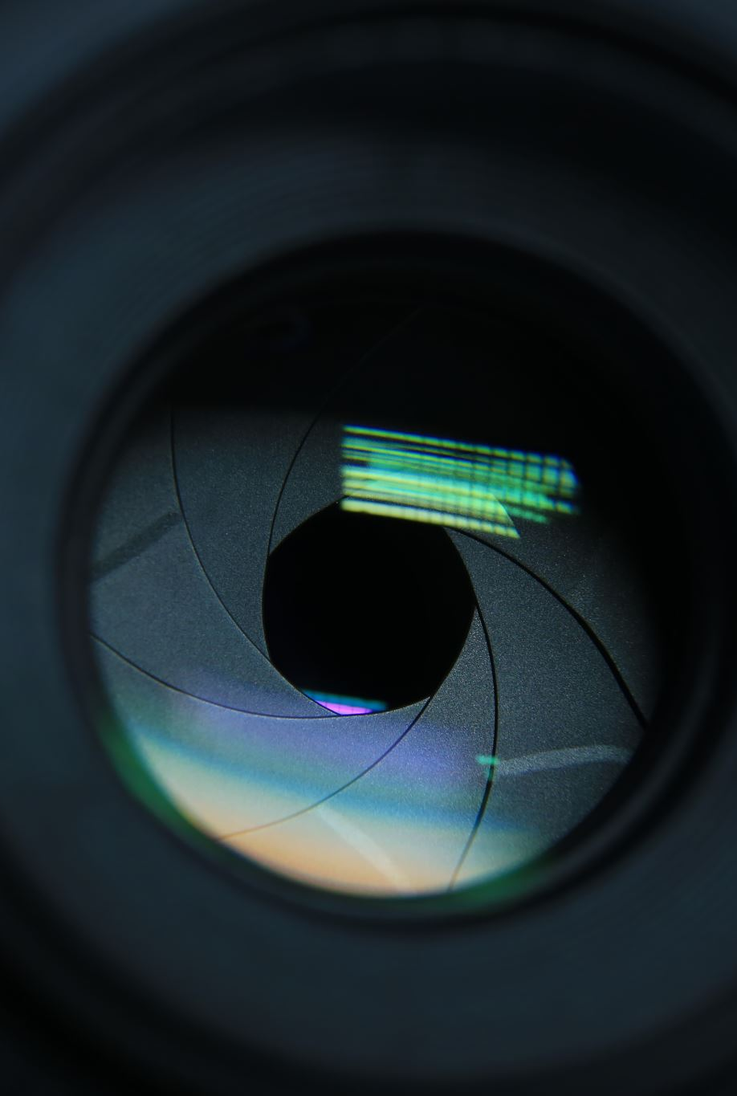
Camera Initialization
this.camera = new window.Camera(this.videoElement, {
onFrame: async () => await this.pose.send({ image: this.videoElement }),
width: 640,
height: 480
});
Captures live webcam feed.
Sends each frame to MediaPipe Pose for analysis.
Displays the camera image and overlays the pose landmarks on the HTML5 <canvas>.

Slide 12
Future scope
Add
Add support for more exercises and advanced poses
Export
Export workout history to cloud storage or mobile sync
Integrate
Integrate with voice feedback or AI recommendations
Build
Eventually build a React or mobile app version for wider accessibility

Slide 13

Thank you

